Slide 1

Mobile Application Development, Fall 2021 Persistent Data via a JSON Server

Slide 2
Today’s Agenda
Today’s Plan
Setting up json-server
Making Server Requests and Fetching Posts
Creating Posts with Post Requests
Editing, Deleting, and Wrapping Up

Slide 3


Today’s Plan
Our blog app is basically feature complete! We have all of the screens up and running!
Index
Show
Create
Edit
Blog List
+
Blog List
Blog List
Blog List
Blog Title
Blog Title
My blog post today is going to be about my favorite things. Rain drops on roses and whiskers on Kittens!
Enter Title:
Enter New Title:
Blog Title
Blog Title
Enter Content:
Enter New Content:
Blog Title
Save
Save

Slide 4
Today’s Plan
BUT, as we discussed last time: if we close out our app, we lose all of our blog posts. Our app doesn’t have persistent data!
Index
Show
Create
Edit
Blog List
+
Blog List
Blog List
Blog List
Blog Title
Blog Title
My blog post today is going to be about my favorite things. Rain drops on roses and whiskers on Kittens!
Enter Title:
Enter New Title:
Blog Title
Blog Title
Enter Content:
Enter New Content:
Blog Title
Save
Save

Slide 5
Today’s Plan
There’s a few solutions to this…
We could save our blog list to our physical device.
In a local Sqlite database, for example.
Which we then read from every time we load up the app.
But there’s another way that is arguably more useful.
One that allows our data to not be bound to just our single, physical phone.

Slide 6
Today’s Plan
We can instead store our list of posts on an outside API server.
And all of the functions that we made will now not only edit LOCAL data, but will perform network requests that affect the data on this server.
Blog List
+
JSON API Server
Create Post
Blog Title
Blog Title
Edit Post
Blog Title
Delete Post
Blog Title
Get All Posts

Slide 7
Today’s Plan
For now, we won’t worry about any concepts such as user accounts.
We are just focusing on storing data on this remote server, and seeing how we can write to it and read from it, to give our app some persistence!
Blog List
+
JSON API Server
Create Post
Blog Title
Blog Title
Edit Post
Blog Title
Delete Post
Blog Title
Get All Posts

Slide 8
Today’s Plan
So, great! But how do we make this sever?
For today, we’re going to be making use of a package called “json-server”
npmjs.com/package/json-server
This is a very simple to use package that makes it very simple to make a server which serves JSON data.
NOTE: json-server is only good for development purposes. Not appropriate for “production”
i.e., for a real-life app you’ve deployed to the real world.

Slide 9
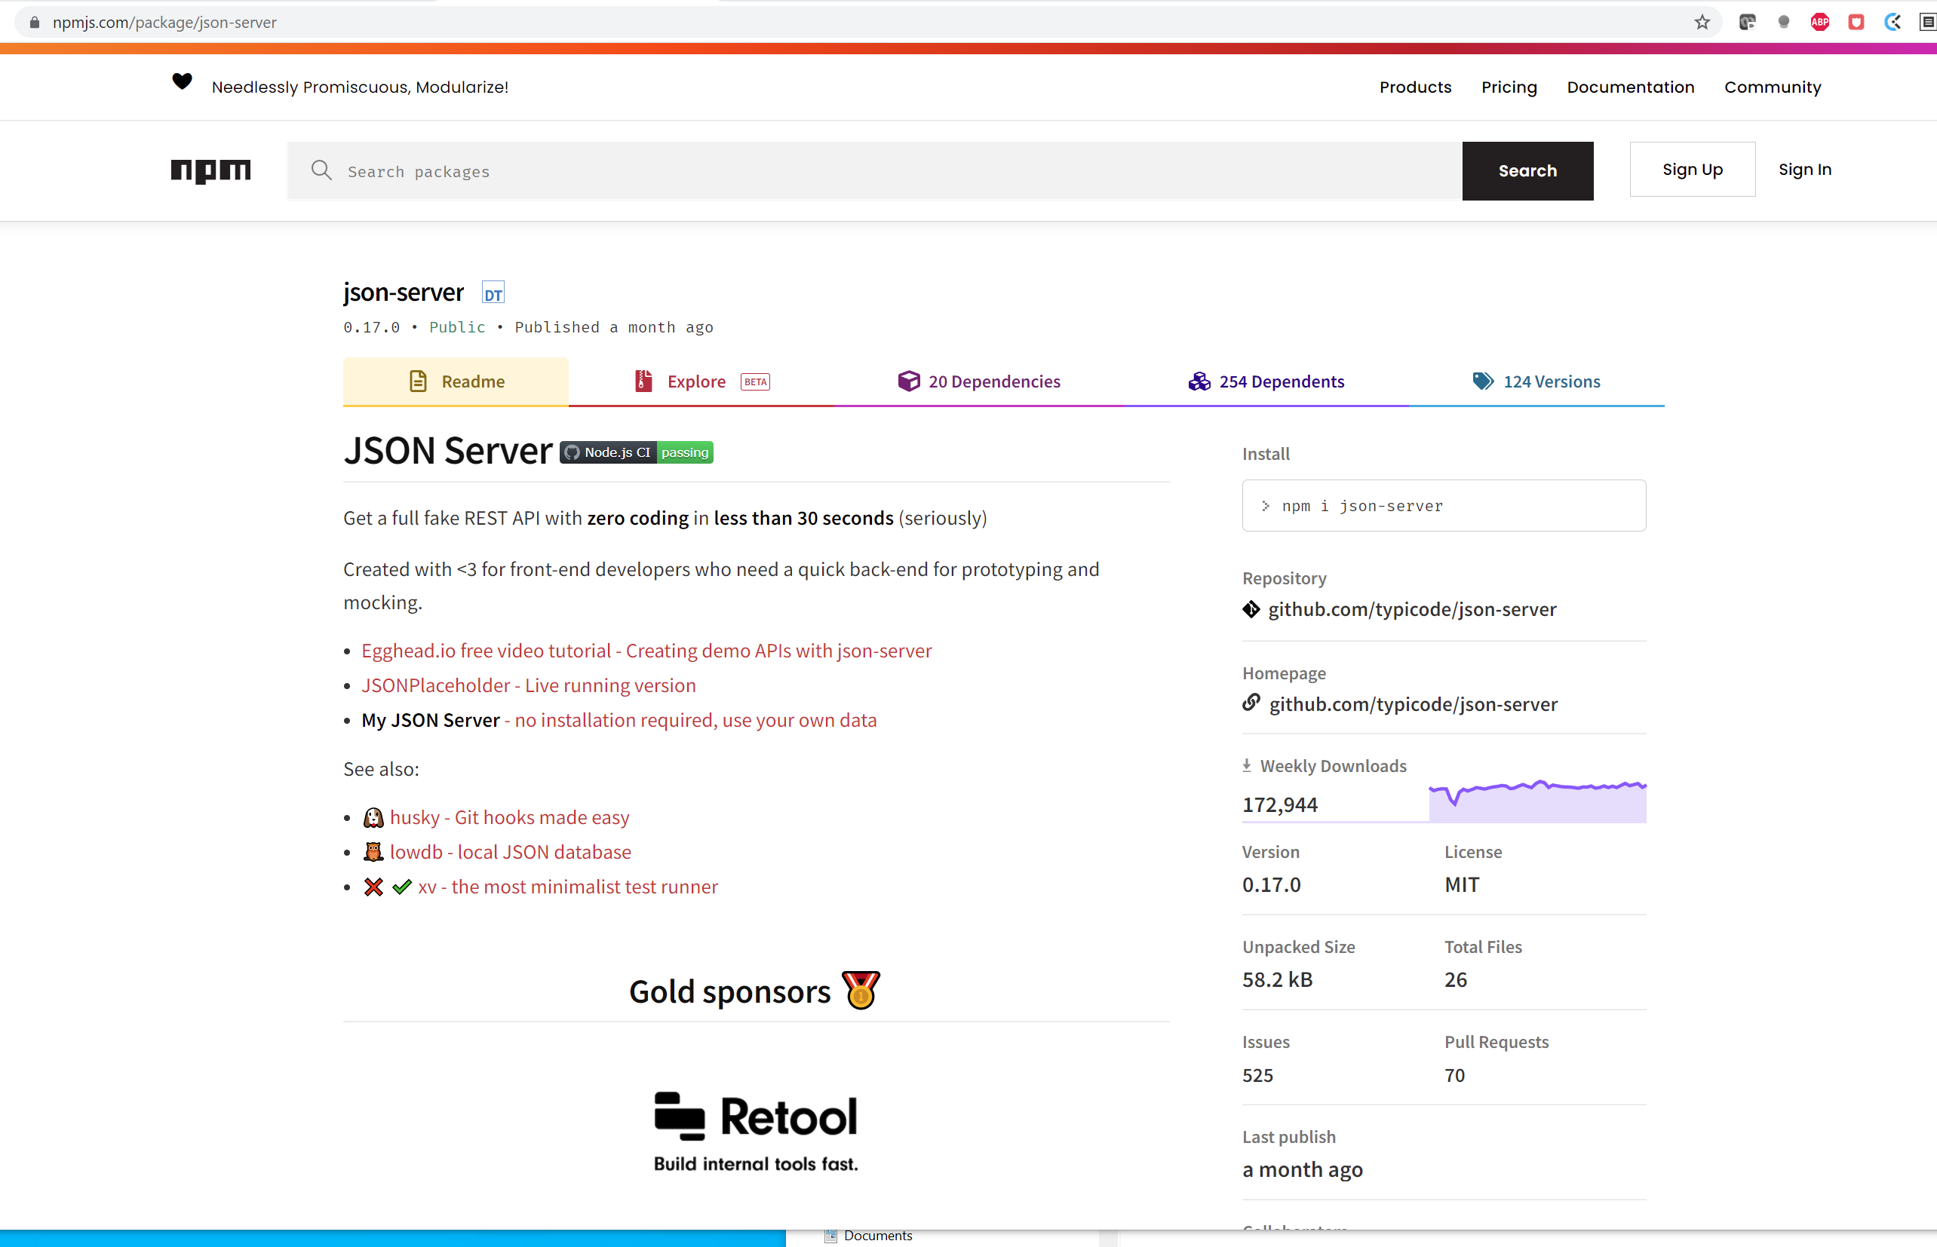

Today’s Plan
You are welcome to read the documentation of json-server.
But I’ll try to cover what you need right here!

Slide 10
Today’s Plan
Getting persistent data in your app is another one of those big “level up” moments!
So let’s get cracking!

Slide 11
Today’s Agenda
Today’s Plan
Setting up json-server
Making Server Requests and Fetching Posts
Creating Posts with Post Requests
Editing, Deleting, and Wrapping Up

Slide 12

Setting up json-server
So, ah, I know that I said…
And the json-server documentation says….
That it is pretty easy to set up the server.

Slide 13
Setting up json-server
And normally that’s true!
However, setting it up with react native is a little harder.
Let’s try and understand why…

Slide 14
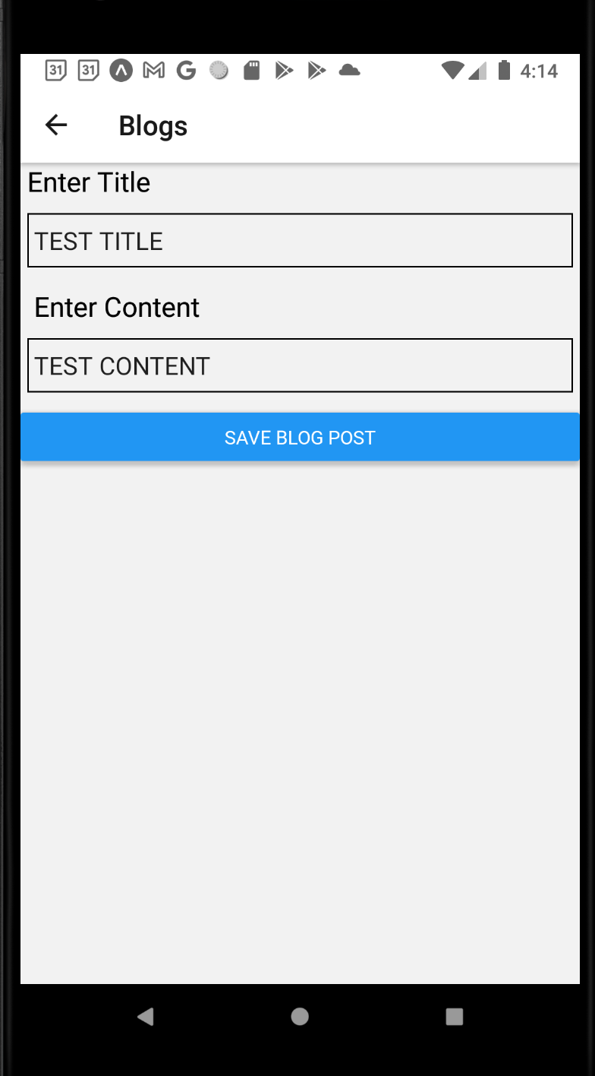
Setting up json-server
Wifi Network
e.g., “unosecure”
First of all: the acknowledgement that some of us are using physical phones, and some of us are using emulators.
So everyone is in a slightly different position with this.
Your Computer
Your Phone

Slide 15
Setting up json-server
Wifi Network
e.g., “unosecure”
But generally, when we set up the metro bundler with ‘npm start’:
We have our phone…
And our phone is communicating with our computer…
Through whatever wifi network we are connected to.
Your Computer
Your Phone

Slide 16
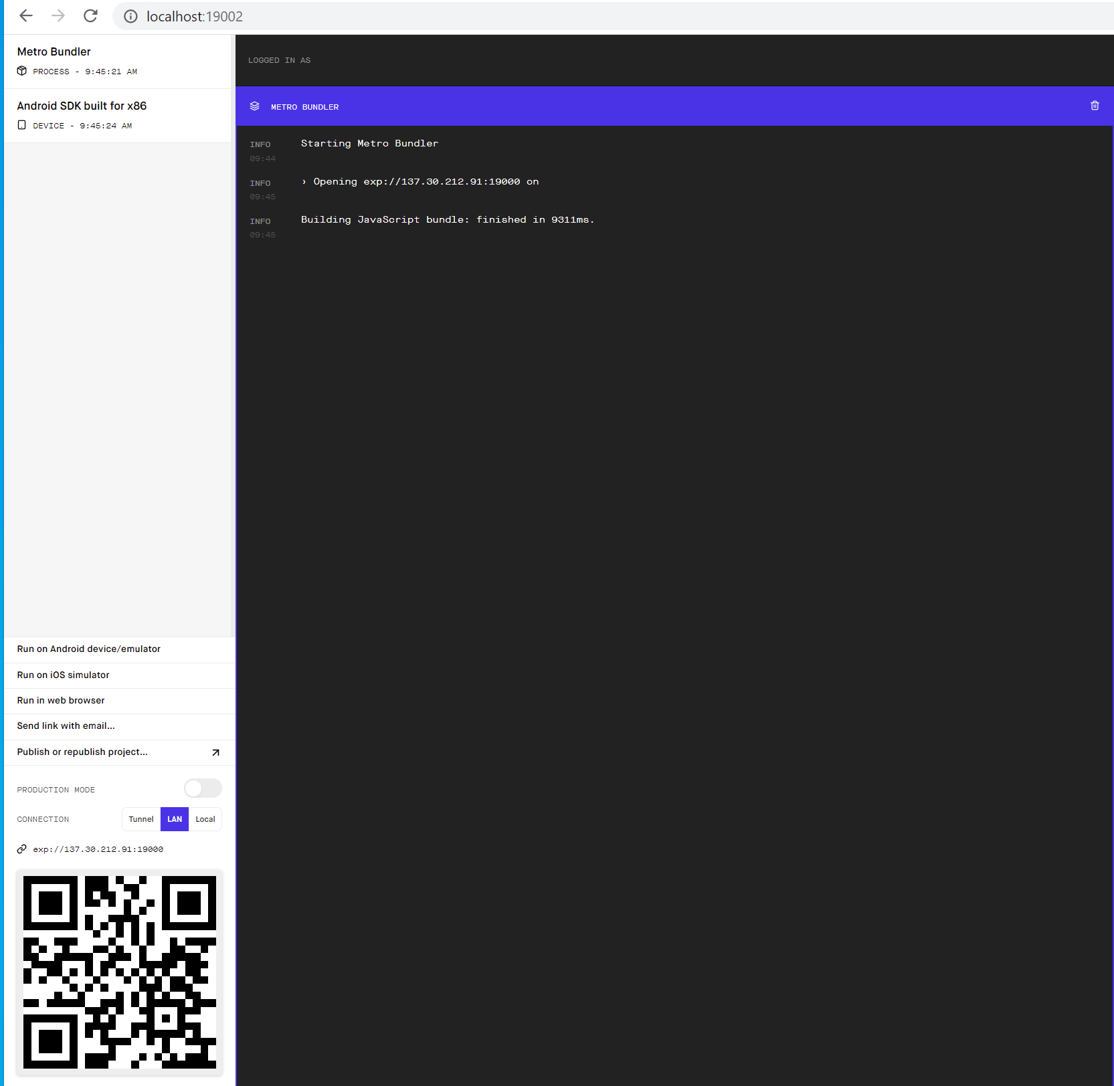

Setting up json-server
And like, already, maybe this is different for some of you.
Technically only using wifi if you were able to get LAN to work for you.
I did for me!
But I know some of you are using “Tunnel” instead.
Which is slightly different, but for today’s conversation is similar enough.

Slide 17

Setting up json-server
Wifi Network
e.g., “unosecure”
SO!
We want our computer to be running this new json-server thing.
That is – we want out computer to run the server that holds the data that will ultimately show up on our phone.
Your Computer
Your Phone

Slide 18

Setting up json-server
Wifi Network
e.g., “unosecure”
The problem is that if we want our phone to be able to “talk” to our computer in this way…
We’d have to do some configuration setting on our computer itself.
We’d need to make use of our IP address…
And the exact set of steps might be a little different if you are using LAN or using TUNNEL
Your Computer
Your Phone

Slide 19
Setting up json-server
Wifi Network
e.g., “unosecure”
That wouldn’t be the end of the world if we had to do that setup!
BUT – we’re going to take a different approach that “should” work 100% of the time for everyone.
But, er, I mean… you know how these things go sometimes.
Your Computer
Your Phone

Slide 20
Setting up json-server
ngrok server
Wifi Network
e.g., “unosecure”
We’re going to be setting up a new tool on our local machine, called “ngrok”
This is a server that makes our computer available to the outside world.
So our phone will be able to talk to our computer using this new ngrok thing.
Your Computer
Your Phone

Slide 21
Setting up json-server
ngrok server
Wifi Network
e.g., “unosecure”
In order to set up ngrok, we’ll have to create a new directory, and set it up with some node packages.
SO… let’s go do that!
Your Computer
Your Phone

Slide 22
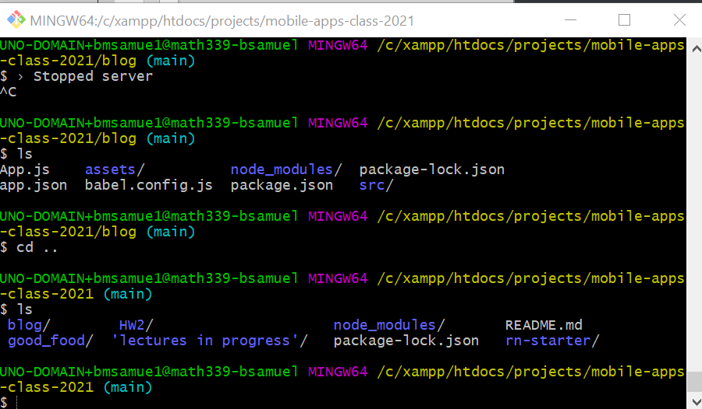
Setting up json-server
Just to let you know where I’m setting it all up relative to everything I’ve done before…
I have my folder where I’ve made directories for each of my projects.
You can see ‘em!
blog, good_food, rn-starter!
Ah, memories!

Slide 23
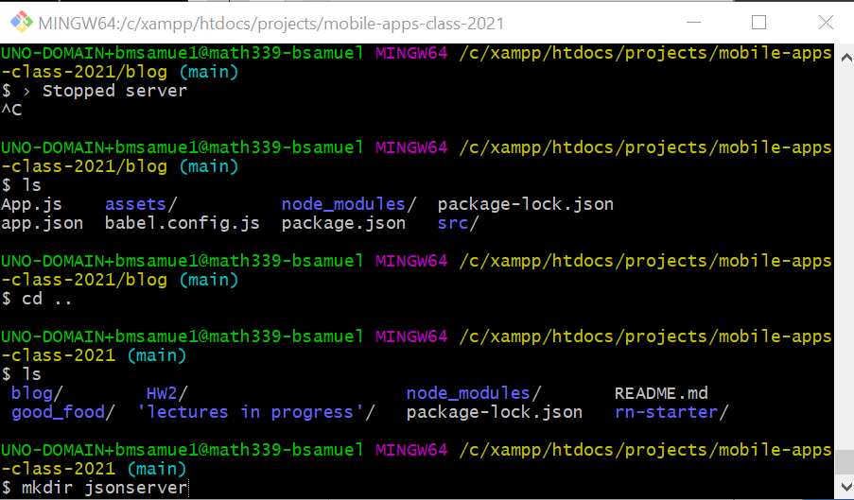

Setting up json-server
And in this directory, I’ll make a new folder called “jsonserver”

Slide 24
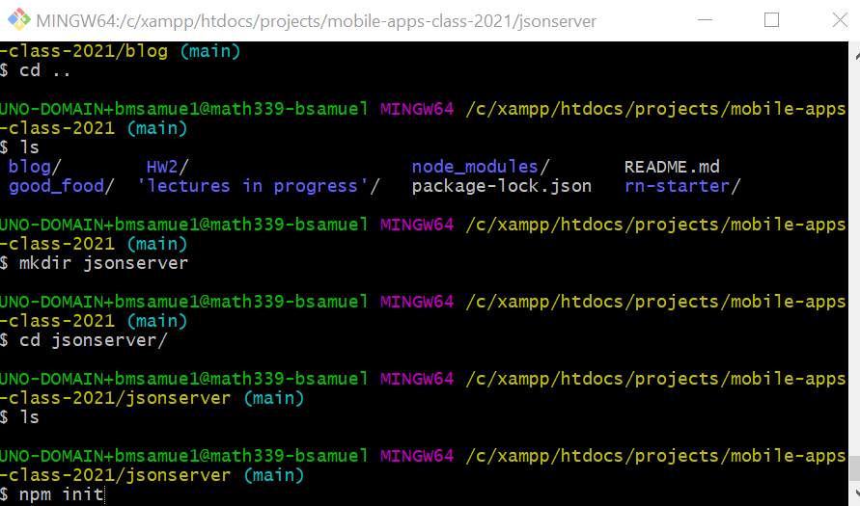

Setting up json-server
Once you’ve made it, cd into it…
And then create a new package.json file with the command
npm init

Slide 25
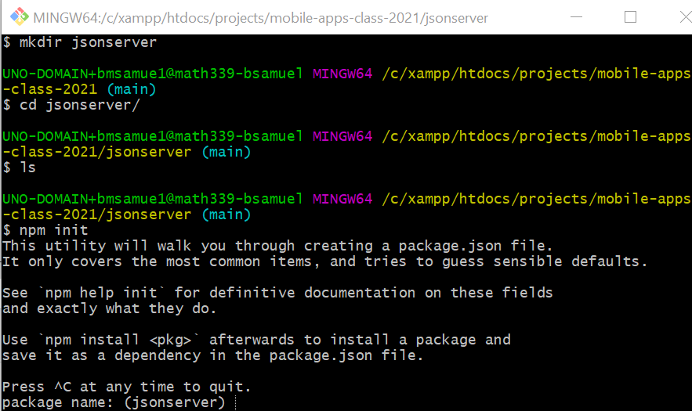
Setting up json-server
Doing that will ask you a bunch of questions.
Just hit enter a bunch. The defaults are fine!

Slide 26
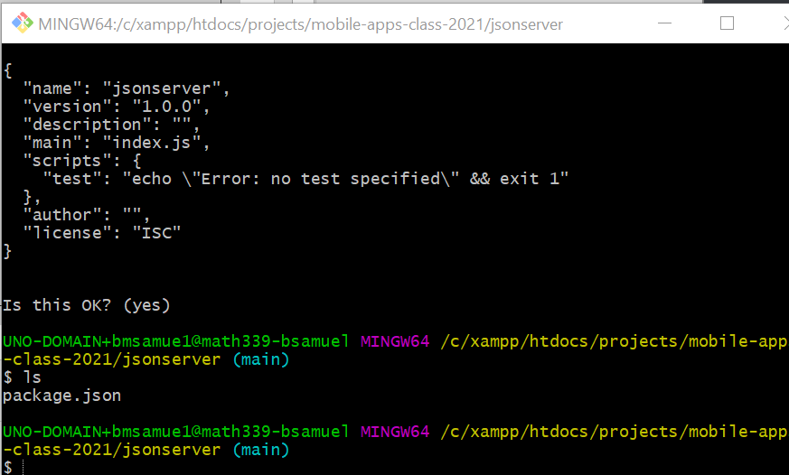
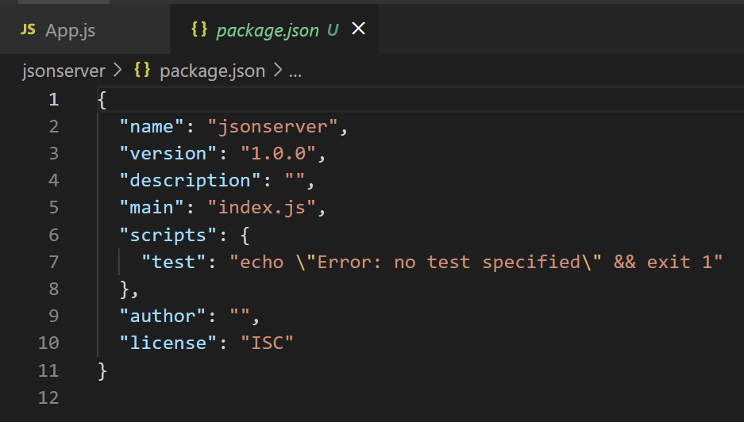
Setting up json-server
And then after that, you’ll find that you now have a new file: package.json in the directory.
And if you were to open it up, you’d see something that looks like the bottom image.

Slide 27
Setting up json-server
Now that we have that package.json file, we can start to install some node modules!
And the package.json file will update automatically as we do so.

Slide 28
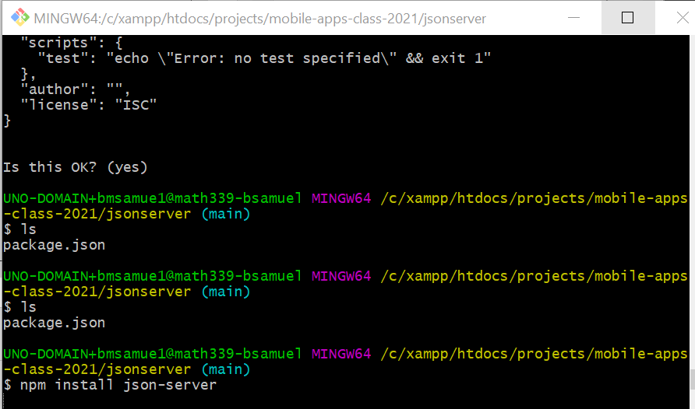
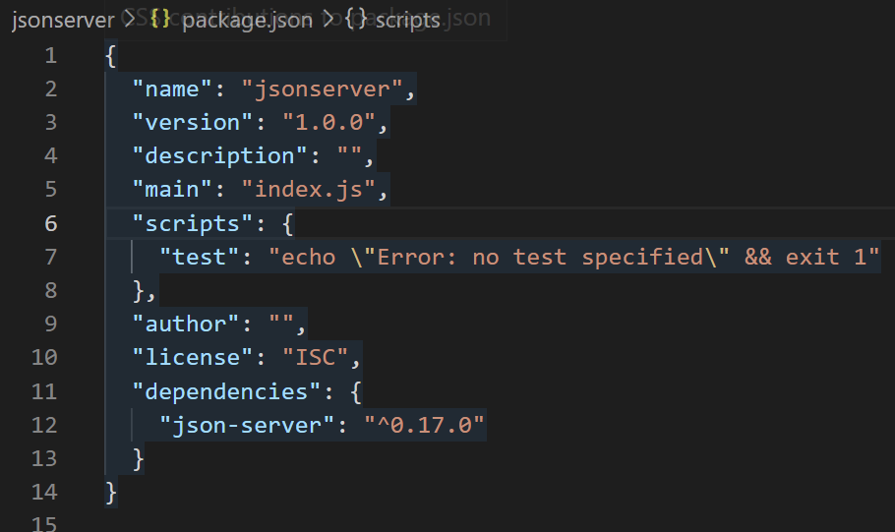

Setting up json-server
First, let’s install that json-server package we were talking about.
On the command line type:
npm install json-server
It’ll take a second but finish pretty soon.
If you wish, you can see that json-server has now been added as a dependency in our package.json file.

Slide 29
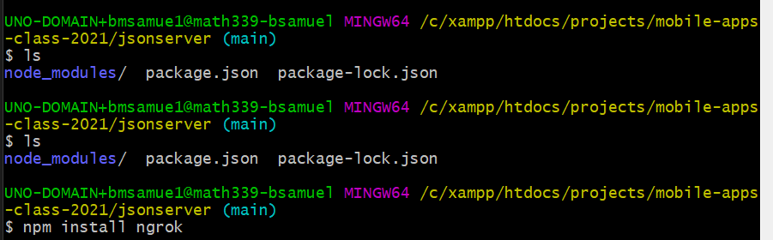
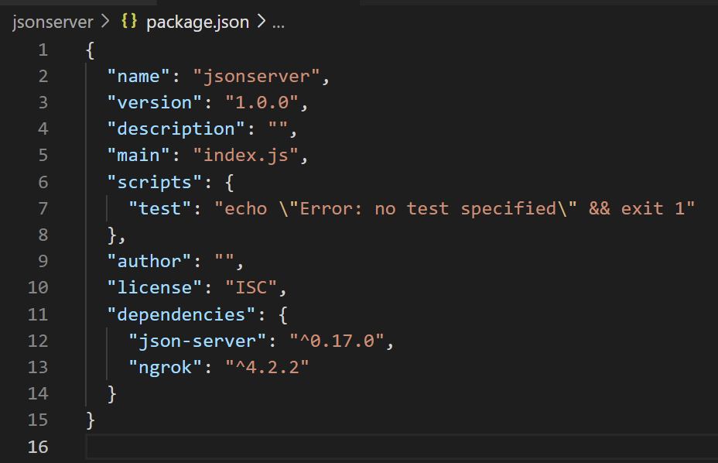


Setting up json-server
We also want to install ngrok, which we can do with the similar command:
npm install ngrok
And lo and behold – ngrok is now included as an additional dependency too.

Slide 30
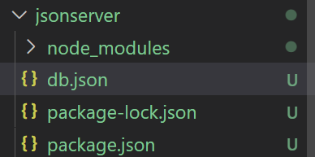

Setting up json-server
Now with the packages installed…
We can start to actually set them up for our specific needs!
To do this, we’ll need to create a new file in this jsonserver directory.
I’ll call it db.json – for database!

Slide 31

Setting up json-server
Note that it is a .json file, not a .js file.
We won’t have “code” here – just data!
This is ultimately where our server will store all of its information.

Slide 32
Setting up json-server
We need to set it up ahead of time, and do some (light) initial configuration…
Just to let the server know about the different “types” of information it needs to manage.
For our blog post app, that’s easy – the only ‘type’ of data we have are blog posts!

Slide 33
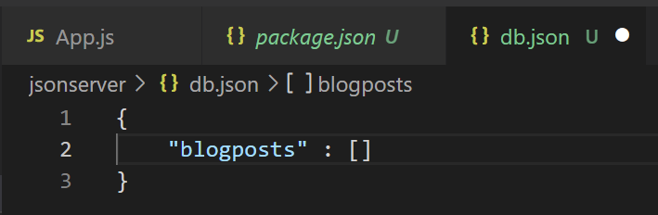
Setting up json-server
So it basically ends up looking just like this!
JSON, recall, stands for “JavaScript Object Notation”
The syntax is basically exactly the same as the objects we’ve been making.
But the keys have to be enclosed in double quotes.

Slide 34
Setting up json-server
But other than that, we’re good!
Our server will store an object…
That object will have one key: blogposts.
And that key will store an array…
An array that will eventually be full of all of the blog posts from our app!

Slide 35
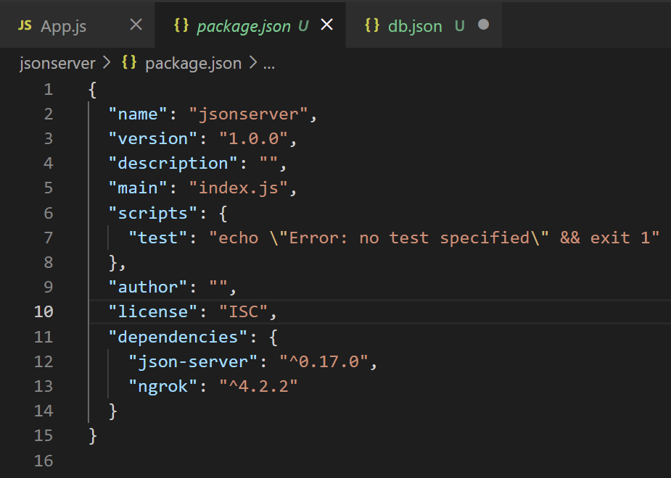
Setting up json-server
We also need to directly edit our package.json file a bit…
We are going to add in two scripts to the scripts section.

Slide 36
Setting up json-server
The scripts will parallel the two packages we just set up.
One will be responsible for starting up json-server
The other for handling ngrok.
(We can also get rid of that weird “test” script while we’re at it).

Slide 37
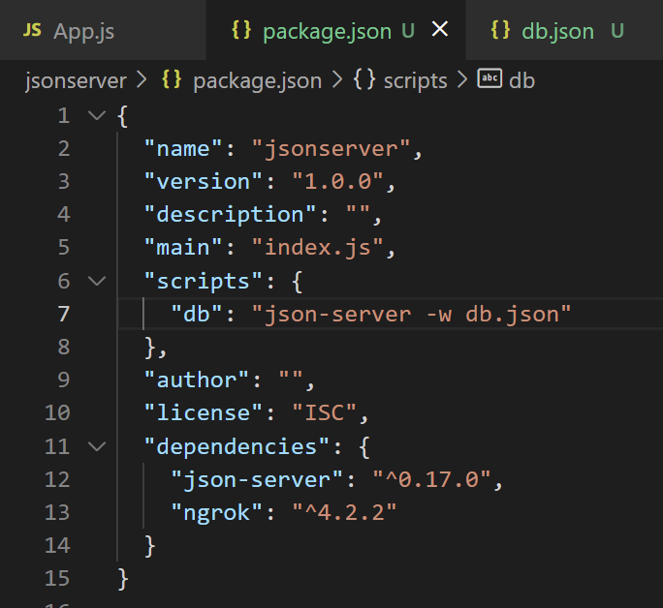

Setting up json-server
So, as promised, first we’ll make a script for json-server.
Now, when we run the script “db”, it’ll be the equivalent of typing onto the command line
json-server –w db.json
The upshot of which is going to start up our json-server.

Slide 38
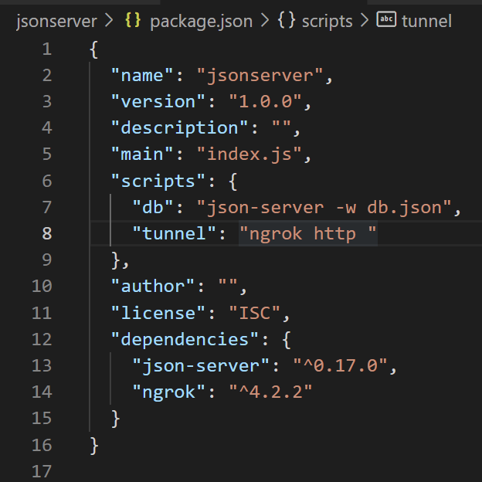

Setting up json-server
We also need a second command for starting up ngrok.
I’ve gotten it started here
I’ve named it tunnel
And the command so far is ‘ngrok http’
We need to provide a port for ngrok to connect to on our local machine.

Slide 39
Setting up json-server
ngrok is basically going to be the thing that we expose to the outside world.
And what we *actually* want the outside world to know about is the data that we are storing in our json-server.
And by default, json-server runs on port 3000….

Slide 40
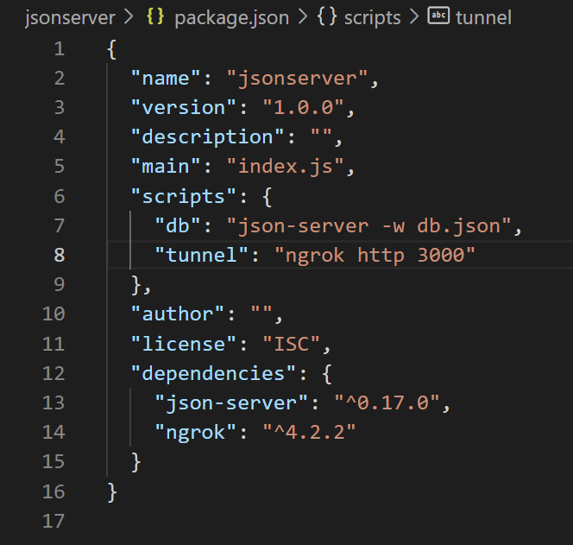


Setting up json-server
So by typing in 3000 here, we are basically saying…
“We are going to expose to the world whatever is being served on port 3000”
Which again, by default, will be our json-server.
Which in turn is going to have the data our app will use.
In this example, just a list of blog posts.

Slide 41

Setting up json-server
NOW – if you are like me…
You might already have OTHER things on your system that use port 3000!
So if you want, you can tell json-server to use a different port if you want!
And then you just have to make sure that ngrok exposes that other port you specified instead.

Slide 42
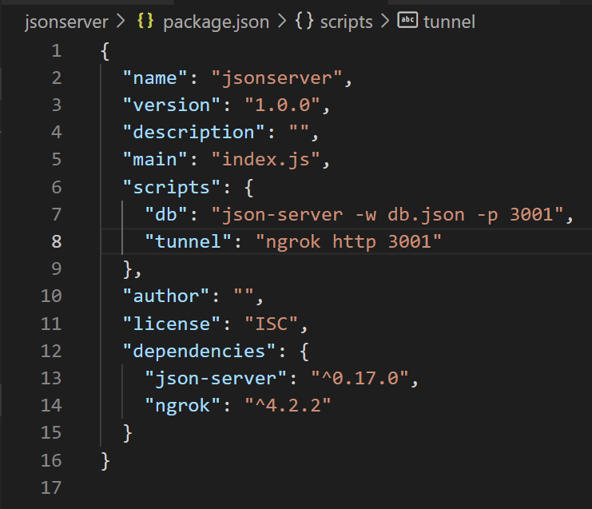
Setting up json-server
You can specify a new port for json-server with the –p flag.
So here, I’m telling json-server to run on port 3001.
And then telling ngrok to serve whatever is on port 3001.
Again: only need to do this if port 3000 is being used by something else.

Slide 43
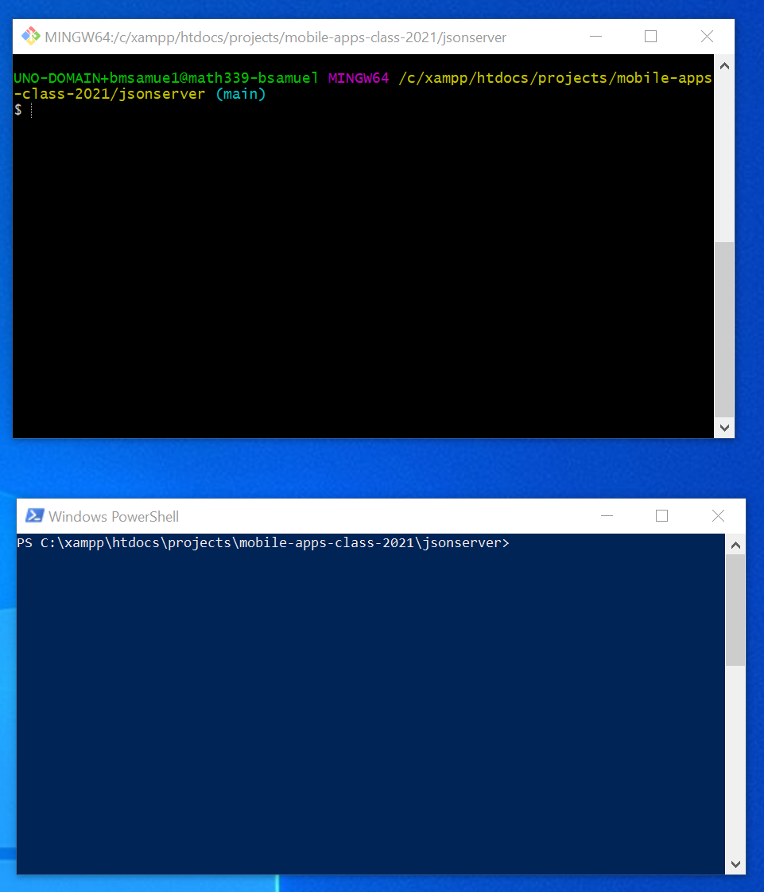
Setting up json-server
So now at this point, you can actually run these commands on the command line!
And I’m going to make a suggestion right now…
Open up two separate terminal windows in the same directory (the one with this package.json file in it).

Slide 44
Setting up json-server
AND if you are using Windows…
Have one of those terminals *NOT* be Gitbash.
Again: for reasons I don’t fully understand, Gitbash doesn’t play nicely with what we’re about to do here…
You can use windows powershell instead.
or the traditional “cmd” command line.

Slide 45
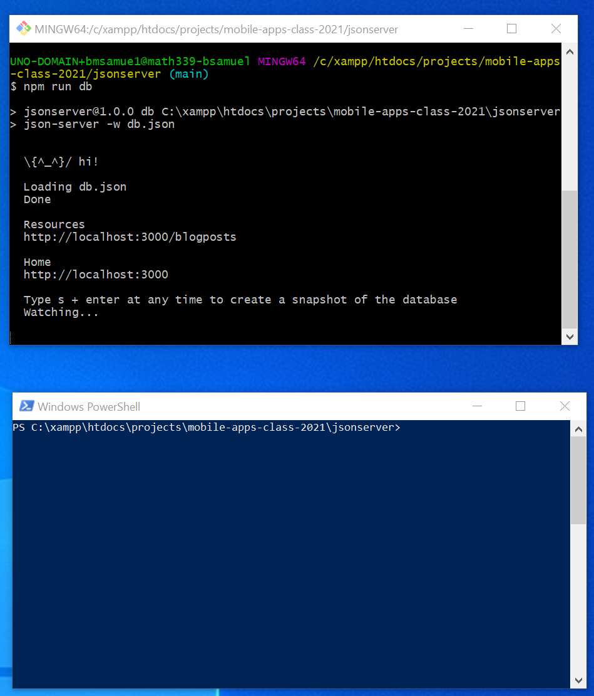


Setting up json-server
Inside of one of your terminals (gitbash is fine for this), type:
npm run db
This runs the “db” script that you just made in the package.json file.
i.e., it is what will start up json-server

Slide 46

Setting up json-server
When you do that, you should see something that looks like this…
That’s great! That means json-server is up and running!
If you get some complaint about port 3000 already being in use, refer to the previous slides about changing what port json-server runs on!
Or close out whatever used to be on port 3000.

Slide 47
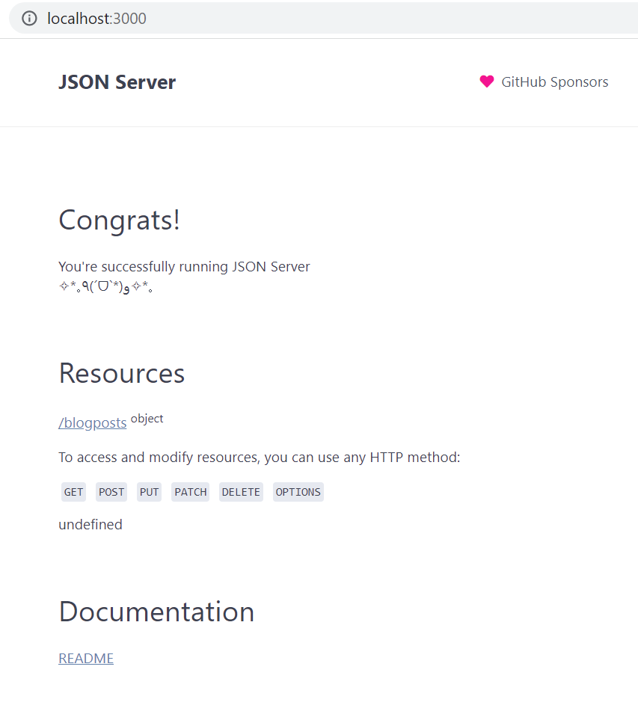

Setting up json-server
SO! NOW! At this moment!
We are successfully running a server on our computer!
If you open a browser, and go to the port you specified, you should see a happy message from json-server.

Slide 48
Setting up json-server
But this is *just* on our local machine.
Nothing else can access this…
Including our phones.

Slide 49
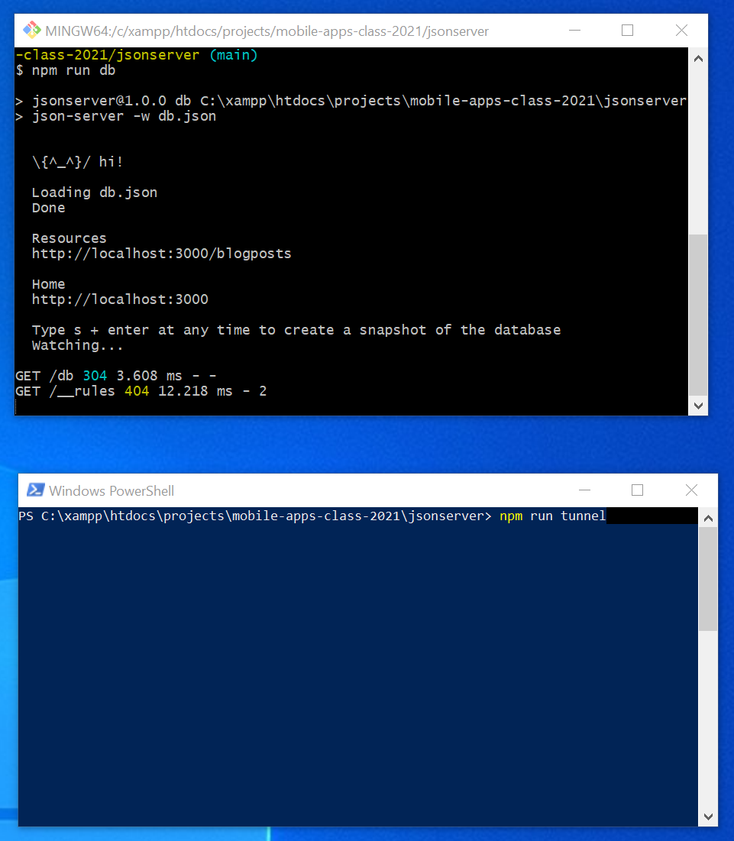

Setting up json-server
So what we’re going to do is set up ngrok to make this port accessible to the outside world.
Thankfully, we already added the command to do that in the package.json file.
In that second terminal window---that *isn’t* git bash---type the following command
npm run tunnel

Slide 50
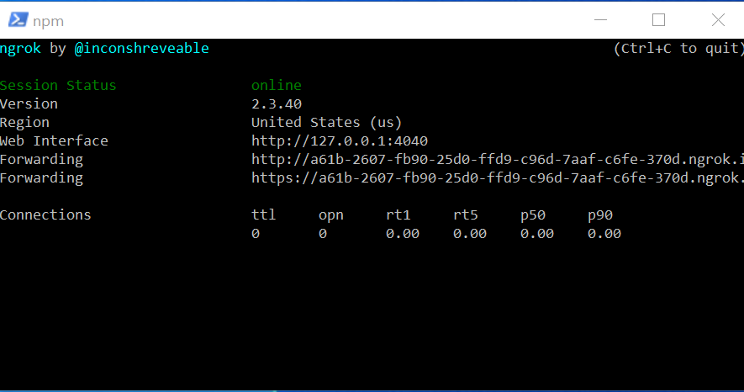
Setting up json-server
When you do that, you should hopefully see a screen that looks like this!
This is the victory screen! If you see this, then you are in great shape!

Slide 51
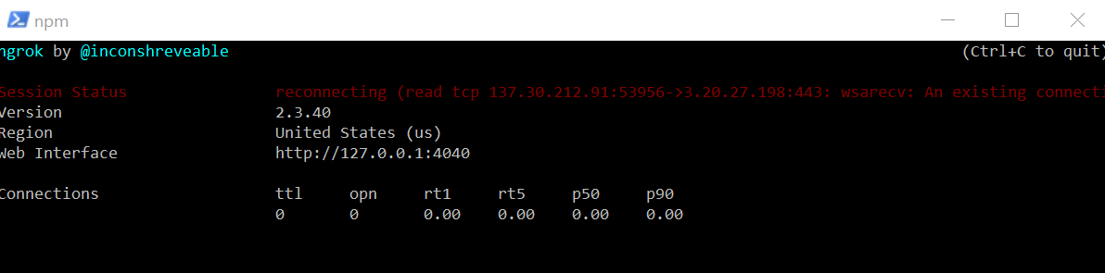
Setting up json-server
However, some of you might not be so lucky.
Some wifi networks aren’t going to be happy about this.
Including, sadly, unosecure
If you only have access to unosecure (or other networks that don’t like this…)
It’s OK! Remember: this whole set up is just for testing purposes anyway.
In real life you’d want an actual server with dedicated webspace.
Funnily enough, using your phone as a wifi hotspot and then connecting your computer to it *could* be a way to get around this!

Slide 52
Setting up json-server
But let’s for now live our lives as if you are seeing this happy screen.
When you see those “Forwarding” lines, you see those addresses. They are pointing directly to your port 3000 on your localhost!
Or, you know, whichever port you specified.

Slide 53

Setting up json-server
Note: I found much more success using the first forwarding line than the second line!
The ‘http’ line.

Slide 54
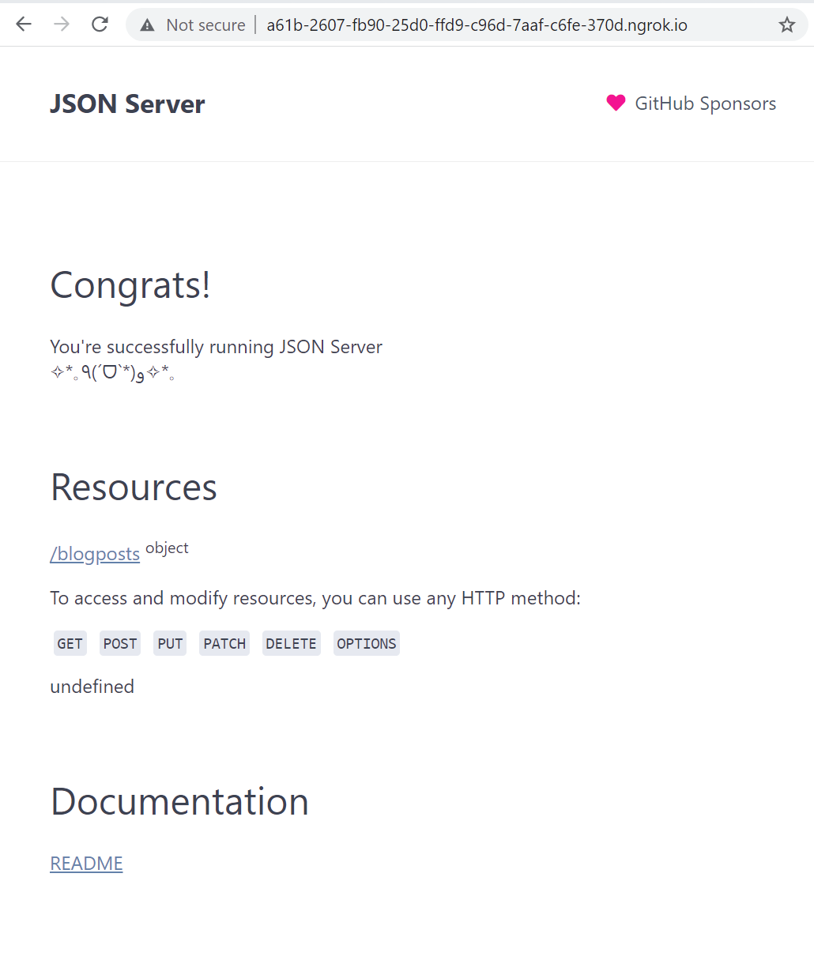
Setting up json-server
If you copy and paste that address into a browser…
You should now see that same json-server we just set up!
Which you should now be able to access on other computers!

Slide 55

Setting up json-server
Also, while we’re here, let’s admire that “blogposts” resource…
It’s there because of the db.json file we set up!

Slide 56
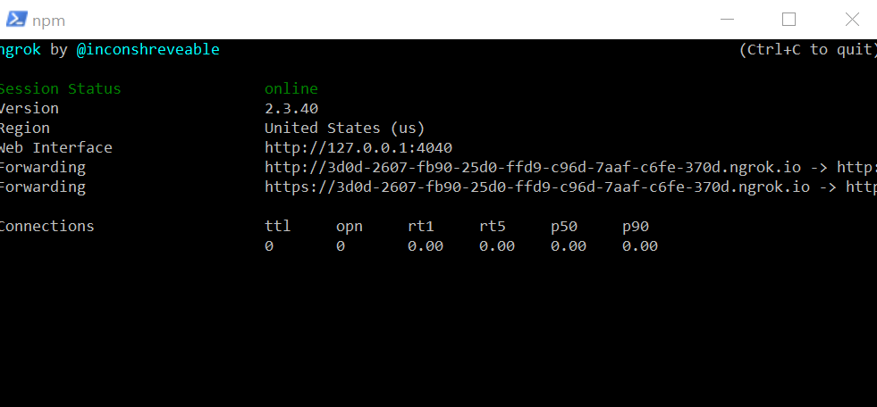
Setting up json-server
Now one thing to keep in mind – ngrok won’t last forever.
Think on the order of hours.
So you’ll have to get used to starting it up again.
(Which you can do with just another execution of npm run tunnel)
I just closed out and started it up again here.

Slide 57
Setting up json-server
However, when you do that, you get a crazy new address!
The URL gets updated!
Again: yet another reason why this is good for testing, but less good for deployment!

Slide 58
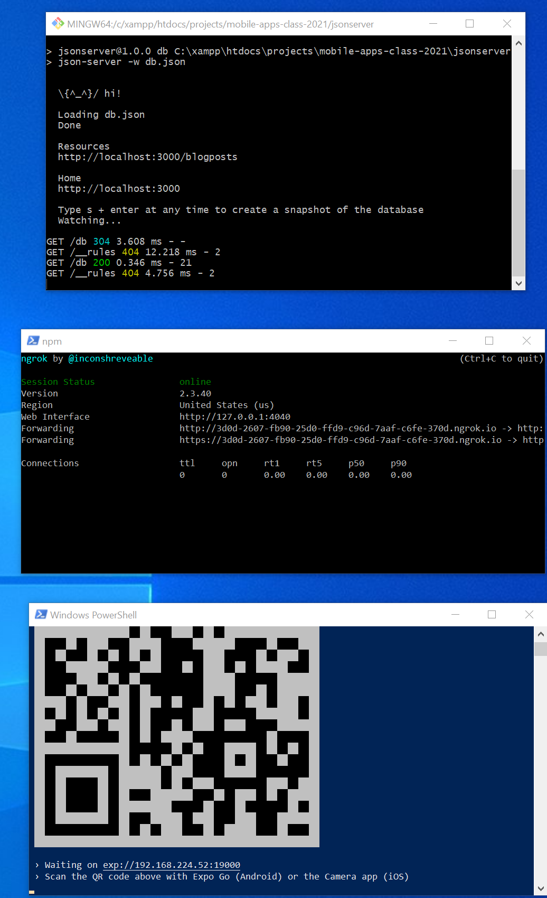
Setting up json-server
So now, at the end of the day, if you want to run our app using this system, we’ll need a total of THREE terminal windows.
One that is running json-server
npm run db
One that is running ngrok
npm run tunnel
And then, finally, one that is running our metro bundler
npm start
You know, the one that we usually run.

Slide 59
Setting up json-server
OH MY GOODNESS.
OK, that’s a lot of terminal windows!
But now that we’ve got it all set up, we’re off to the races!
Let’s start making use of these suckers!

Slide 60
Today’s Agenda
Today’s Plan
Setting up json-server
Making Server Requests and Fetching Posts
Creating Posts with Post Requests
Editing, Deleting, and Wrapping Up

Slide 61
Today’s Agenda
Today’s Plan
Setting up json-server
Making Server Requests and Fetching Posts

Slide 62
Server Requests
OK, so now we HAVE the servers.
Now it’s a matter of actually accessing those servers FROM our app!
In order to do that, we’re going to be making more network requests.

Slide 63
Server Requests
The last time we worked with network requests was with the Yelp API for our restaurant app.
You might recall, we used the Axios library for that.
We’re going to be doing the same for this app!

Slide 64
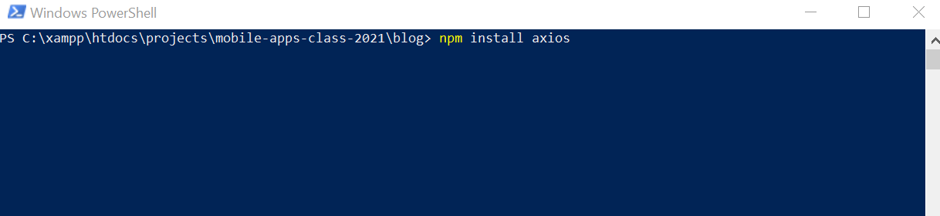
Server Requests
So we’ll need to install Axios for this new project too.
Open up another terminal window (lol) and in the same directory as your package.json file, type:
npm install axios

Slide 65
Server Requests
Let’s take a moment to give ourselves a bird’s eye view as to what we are going to be doing here…
Method
Route
Result
GET
/blogposts
Retrieve all stored blog posts
GET
/blogposts/{id}
Get blog post with particular ID
POST
/blogposts
Create a new blog post.
PUT
/blogposts/{id}
Update blog post with given ID
DELETE
/blogposts/{id}
Delete blog post with given ID

Slide 66
Server Requests
There will be a strict set of rules of the ways that we are “allowed” to access the data on the server.
Method
Route
Result
GET
/blogposts
Retrieve all stored blog posts
GET
/blogposts/{id}
Get blog post with particular ID
POST
/blogposts
Create a new blog post.
PUT
/blogposts/{id}
Update blog post with given ID
DELETE
/blogposts/{id}
Delete blog post with given ID

Slide 67



Server Requests
So for example, any time we want to get all of the blog posts…
We need to make a “GET” type request…
To the /blogposts end point on our json-server
Method
Route
Result
GET
/blogposts
Retrieve all stored blog posts
GET
/blogposts/{id}
Get blog post with particular ID
POST
/blogposts
Create a new blog post.
PUT
/blogposts/{id}
Update blog post with given ID
DELETE
/blogposts/{id}
Delete blog post with given ID

Slide 68



Server Requests
If we instead make a GET request…
To /blogposts/{id}
i.e., … we provide the id of a specific blog post we are interested in…
Then the server will respond with information JUST about that one blog post.
Method
Route
Result
GET
/blogposts
Retrieve all stored blog posts
GET
/blogposts/{id}
Get blog post with particular ID
POST
/blogposts
Create a new blog post.
PUT
/blogposts/{id}
Update blog post with given ID
DELETE
/blogposts/{id}
Delete blog post with given ID

Slide 69
Server Requests
One quick comment: json-server is going to automatically create ids for us.
So we’ll update our app to not make ids manually, and instead just use the ids that json-server makes for us.
Method
Route
Result
GET
/blogposts
Retrieve all stored blog posts
GET
/blogposts/{id}
Get blog post with particular ID
POST
/blogposts
Create a new blog post.
PUT
/blogposts/{id}
Update blog post with given ID
DELETE
/blogposts/{id}
Delete blog post with given ID

Slide 70
Server Requests
All of these rules are things that json-server provides us with automatically!
Method
Route
Result
GET
/blogposts
Retrieve all stored blog posts
GET
/blogposts/{id}
Get blog post with particular ID
POST
/blogposts
Create a new blog post.
PUT
/blogposts/{id}
Update blog post with given ID
DELETE
/blogposts/{id}
Delete blog post with given ID

Slide 71
Server Requests
Now, keep in mind: these routes aren’t the whole thing.
We’ll need to specify full URLs…
With the “first part” being the url that ngrok created for us.
So you can imagine that in front of each of these routes is the URL that ngrok made. I’ve added it to that first one!
Method
Route
Result
GET
http://3d0d-2607-fb90-25d0-ffd9-c96d-7aaf-c6fe-370d.ngrok.io/blogposts
Retrieve all stored blog posts
GET
/blogposts/{id}
Get blog post with particular ID
POST
/blogposts
Create a new blog post.
PUT
/blogposts/{id}
Update blog post with given ID
DELETE
/blogposts/{id}
Delete blog post with given ID

Slide 72
Server Requests
That’s why each time we start ngrok, we’ll have to update our source code with the address.
Again: in real life you’d want your own webspace.
But those typically cost money!
So this way is cheaper!
Method
Route
Result
GET
http://3d0d-2607-fb90-25d0-ffd9-c96d-7aaf-c6fe-370d.ngrok.io/blogposts
Retrieve all stored blog posts
GET
/blogposts/{id}
Get blog post with particular ID
POST
/blogposts
Create a new blog post.
PUT
/blogposts/{id}
Update blog post with given ID
DELETE
/blogposts/{id}
Delete blog post with given ID

Slide 73
Server Requests
OK, with this under our belt, we’re just about ready to start actually updating the application.
Let’s take a look at one more diagram – the new flow of data that our app will take.
Method
Route
Result
GET
http://3d0d-2607-fb90-25d0-ffd9-c96d-7aaf-c6fe-370d.ngrok.io/blogposts
Retrieve all stored blog posts
GET
/blogposts/{id}
Get blog post with particular ID
POST
/blogposts
Create a new blog post.
PUT
/blogposts/{id}
Update blog post with given ID
DELETE
/blogposts/{id}
Delete blog post with given ID

Slide 74
Server Requests
OK, with this under our belt, we’re just about ready to start actually updating the application.
Let’s take a look at one more diagram – the new flow of data that our app will take.

Slide 75
Server Requests
Current Flow
IndexScreen gets displayed by React Navigation
As you may recall, this is our app’s current data flow.
Not too scary, right?
We spent several days talking about it!
IndexScreen looks at context object to get the current list of blog posts.
IndexScreen renders list of blog posts.
All done!

Slide 76
Server Requests
New Flow
IndexScreen gets displayed by React Navigation
And here’s the new flow!
Similar but different in a few ways!
IndexScreen calls a function that makes a request to the server for the current list of posts
IndexScreen receives the list of current blog posts (probably empty!)
Time passes…
The request completes! The List of blog posts gets stored through the ‘useReducer’ hook.
This changes the state! The whole app gets rerendered. IndexScreen now displays the posts.

Slide 77
Server Requests
New Flow
IndexScreen gets displayed by React Navigation
A major difference is that now we need to actually make a network request to get the blog posts.
Keep in mind: network requests take time.
IndexScreen calls a function that makes a request to the server for the current list of posts
IndexScreen receives the list of current blog posts (probably empty!)
Time passes…
The request completes! The List of blog posts gets stored through the ‘useReducer’ hook.
This changes the state! The whole app gets rerendered. IndexScreen now displays the posts.

Slide 78
Server Requests
New Flow
IndexScreen gets displayed by React Navigation
So while it waits for that data to come back from the network request, the app if gonna just charge ahead.
Without the data, it *can’t* render the list of posts… so it’ll likely just print out an empty screen.
IndexScreen calls a function that makes a request to the server for the current list of posts
IndexScreen receives the list of current blog posts (probably empty!)
Time passes…
The request completes! The List of blog posts gets stored through the ‘useReducer’ hook.
This changes the state! The whole app gets rerendered. IndexScreen now displays the posts.

Slide 79
Server Requests
New Flow
IndexScreen gets displayed by React Navigation
BUT EVENTUALLY we will get the data back!
When we do, we’ll make use of our reducer, storing the data locally within the app.
IndexScreen calls a function that makes a request to the server for the current list of posts
IndexScreen receives the list of current blog posts (probably empty!)
Time passes…
The request completes! The List of blog posts gets stored through the ‘useReducer’ hook.
This changes the state! The whole app gets rerendered. IndexScreen now displays the posts.

Slide 80
Server Requests
New Flow
IndexScreen gets displayed by React Navigation
This causes the app to rerender, and the user will be able to see all of the posts.
IndexScreen calls a function that makes a request to the server for the current list of posts
IndexScreen receives the list of current blog posts (probably empty!)
Time passes…
The request completes! The List of blog posts gets stored through the ‘useReducer’ hook.
This changes the state! The whole app gets rerendered. IndexScreen now displays the posts.

Slide 81
Server Requests
New Flow
IndexScreen gets displayed by React Navigation
OK!
Let’s do it! Let’s get to coding!
The first thing we’ll do: is set up an axios instance for this new app!
IndexScreen calls a function that makes a request to the server for the current list of posts
IndexScreen receives the list of current blog posts (probably empty!)
Time passes…
The request completes! The List of blog posts gets stored through the ‘useReducer’ hook.
This changes the state! The whole app gets rerendered. IndexScreen now displays the posts.

Slide 82
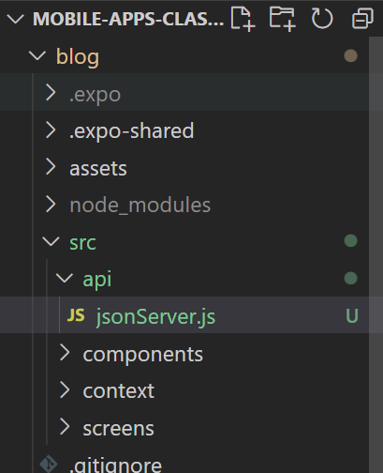
Server Requests
So to be clear: we’re back to our ‘blog’ directory – the same app we’ve been working on.
Inside of src, create a new api folder
And create a file jsonServer.js – we’ll use this to export a new axios instance to connect to our server.

Slide 83
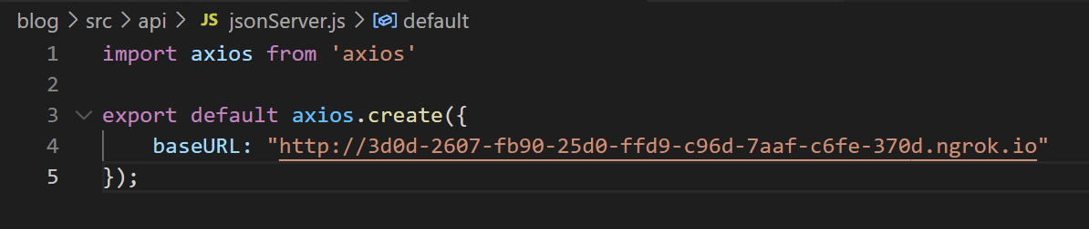
Server Requests
And fill it up with the above.
Remember: this is us creating an axios instance.
We’d want a separate one for each server we’re speaking to.
e.g., one for our own personal server, one for yelp, one for google maps, etc.
We’ll fill in baseURL with the URL that ngrok gave us.
Remember: this ends up being the, well, base URL that goes before all network requests we end up making with this instance.

Slide 84
Server Requests
ALSO recall: every time ngrok ends, we’ll start it up again and it will give us a NEW url.
So we’ll have to go into the source code and change this each time that happens.
That’s pretty hairy!
But owning your own webspace with a static url, or paying for ngrok, are ways to avoid doing that.

Slide 85
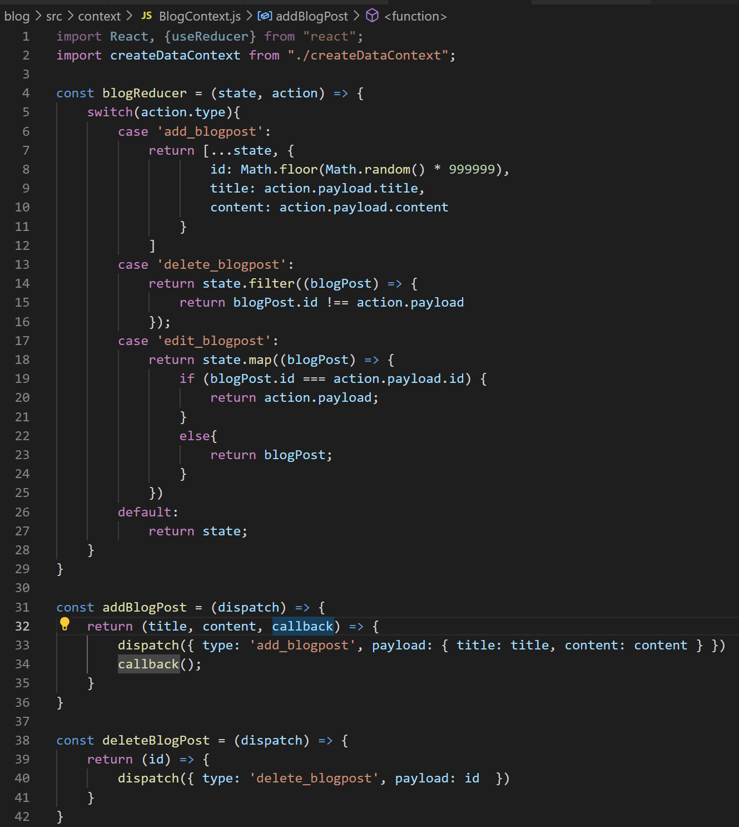
Server Requests
With this under our belts, we can now open up BlogContext.js, and start making use of this axios instance inside of our action functions.
Things like “addBlogPost” and “deleteBlogPost”

Slide 86
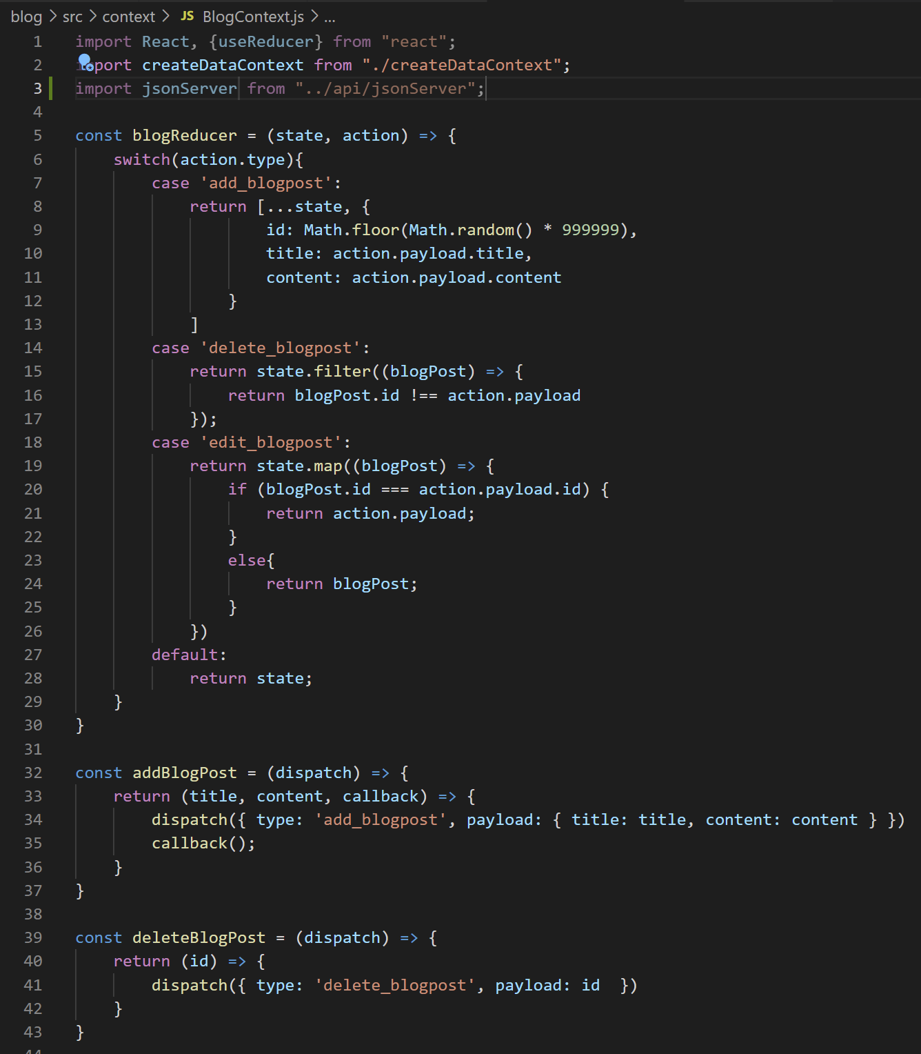

Server Requests
So first thing: make sure you import our new axios instance.
Now – the first action we want to do is, hilariously enough, an action we don’t have a function for – getting the full list of blog posts!

Slide 87
Server Requests
New Flow
IndexScreen gets displayed by React Navigation
We didn’t need to do it before because we just always “had” it.
But now the first thing our app needs to be able to do is request the full list of blog posts from the server.
IndexScreen calls a function that makes a request to the server for the current list of posts
IndexScreen receives the list of current blog posts (probably empty!)
Time passes…
The request completes! The List of blog posts gets stored through the ‘useReducer’ hook.
This changes the state! The whole app gets rerendered. IndexScreen now displays the posts.

Slide 88
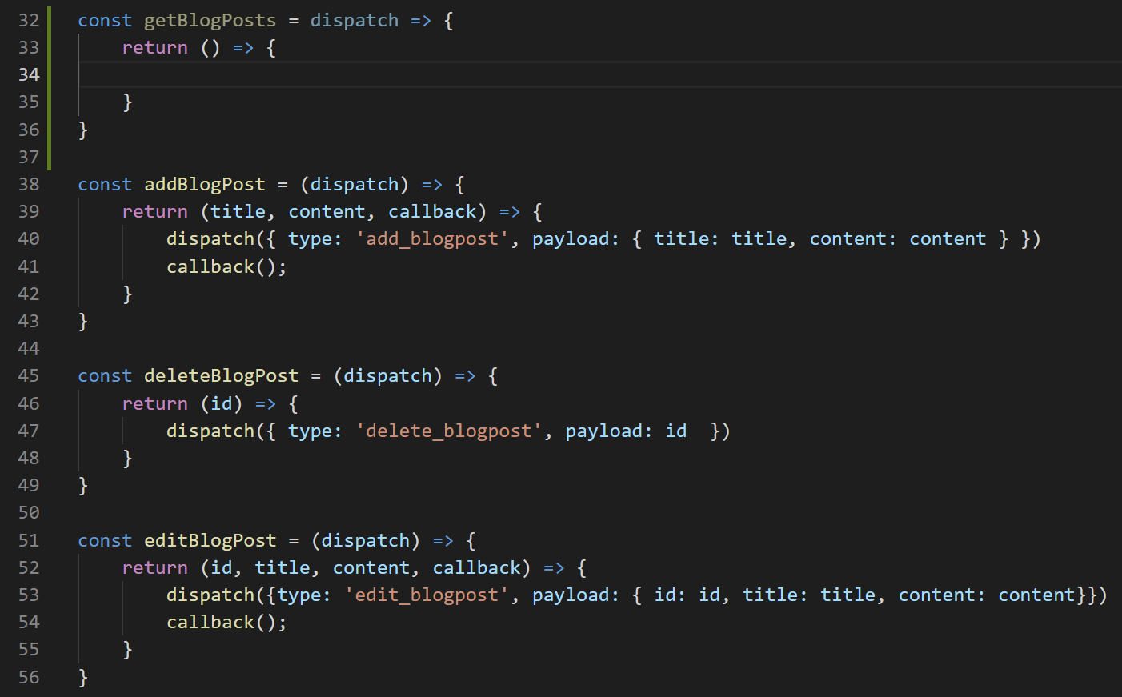

Server Requests
So we’ll add a new function, getBlogPosts(), that rubs shoulders with our other action functions.

Slide 89
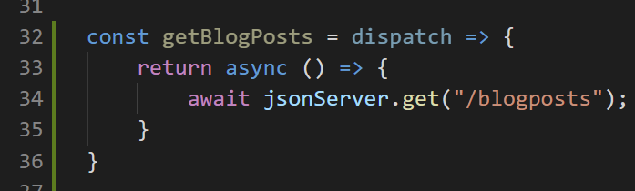
Server Requests
And it can now look a little something like this!
We’ll mark the function that getBlogPosts returns as asynchronous with the async keyword.
And we’ll use out axios instance to access /blogposts.

Slide 90

Server Requests
Recall the route we need is /blogposts
Method
Route
Result
GET
/blogposts
Retrieve all stored blog posts
GET
/blogposts/{id}
Get blog post with particular ID
POST
/blogposts
Create a new blog post.
PUT
/blogposts/{id}
Update blog post with given ID
DELETE
/blogposts/{id}
Delete blog post with given ID

Slide 91
Server Requests
And that axios automatically concatenates the baseURL with the provided route name here.
So behind the scenes, we are making a request to (something like)…
http://3d0d-2607-fb90-25d0-ffd9-c96d-7aaf-c6fe-370d.ngrok.io/blogposts

Slide 92
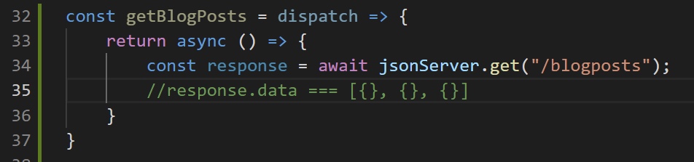
Server Requests
Eventually, that .get() call will return our response, which we’ll store in a variable.
And recall: The response object will have a .data property, that actually has what we care about.
Here: an array of objects, where each object is a blog post.
Eventually! It will start off empty of course.

Slide 93
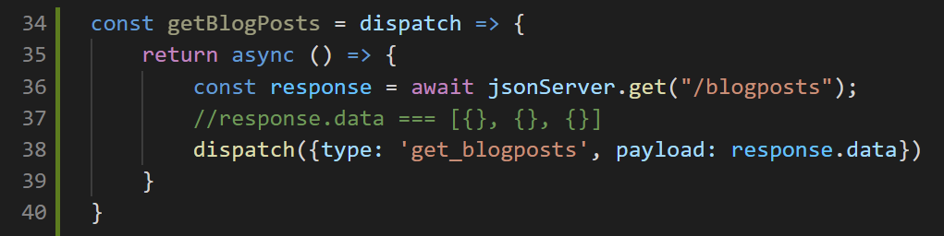
Server Requests
And then, once we get the response, it then becomes a question of updating the app itself!
We’ll do that in the same way we have done: with our reducer!
So let’s make a call to our reducer’s dispatch function!

Slide 94
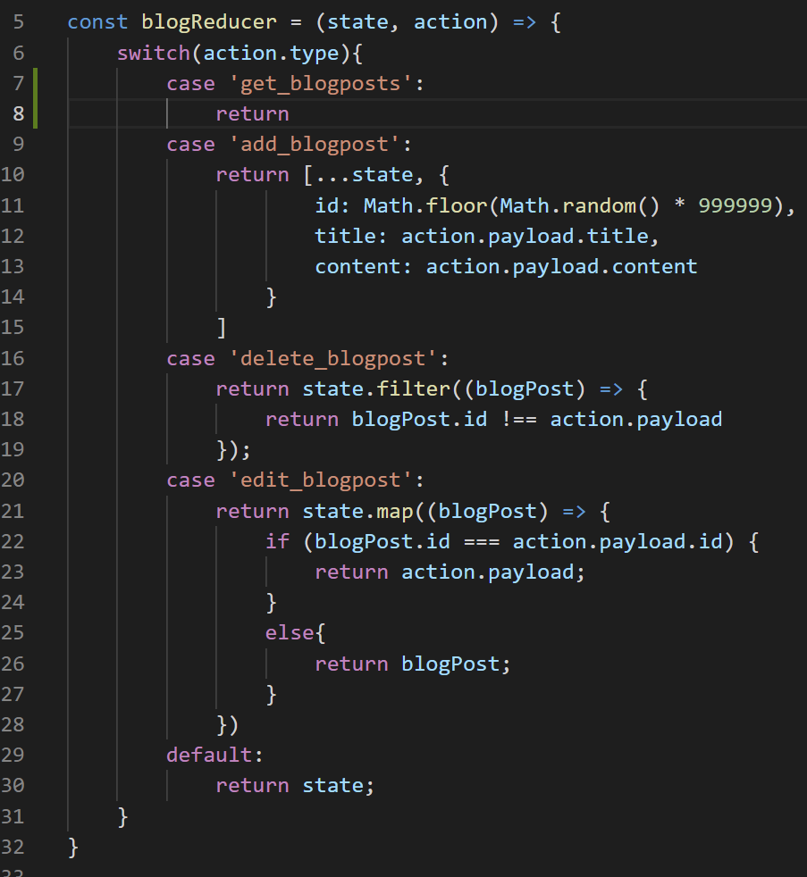

Server Requests
Of course, now we need to add in another case in our reducer for “get_blogposts”
But that isn’t too hard either.
I’ve gotten it started for you…
But what should it return?

Slide 95
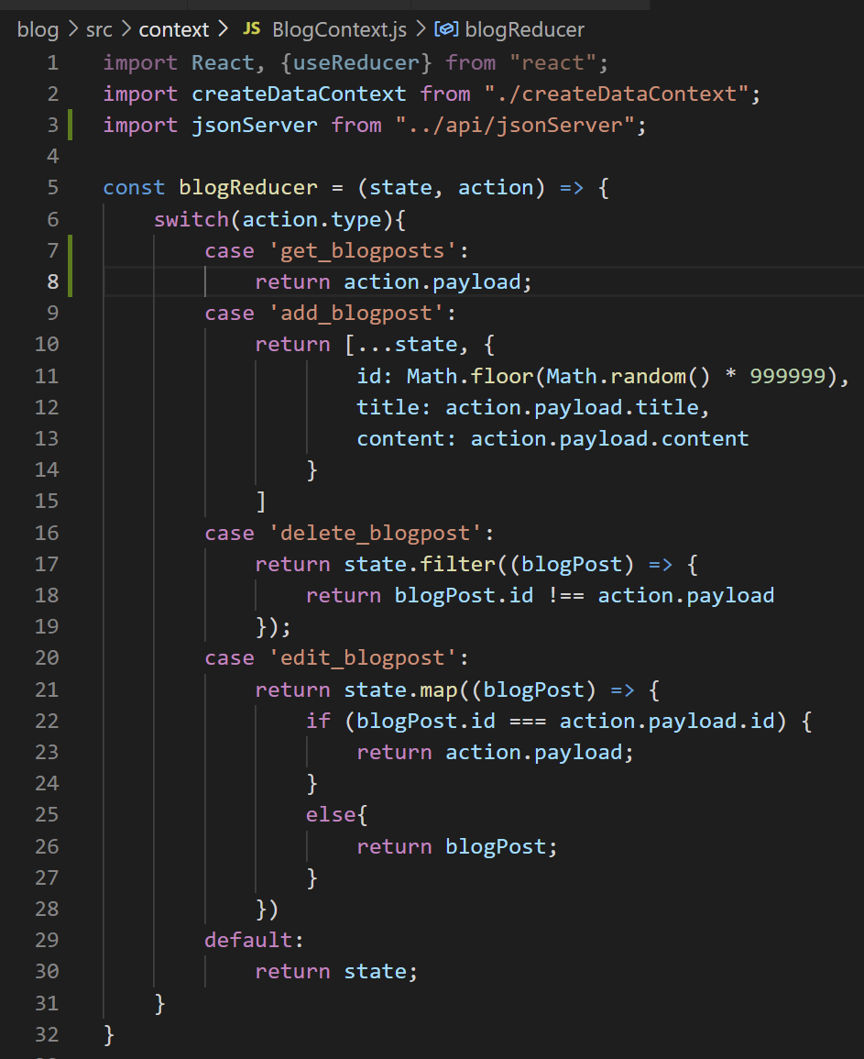

Server Requests
It’s just action.payload!
Because our payload IS just the data we got back from the server…
And we are using that as our ground truth. Whatever the server says is our list of blog posts, IS our list.
So tell our reducer to update our local state based on it!

Slide 96


Server Requests
And one last tiny thing…
Don’t’ forget that the way we have this set up, we need to include all of our action functions into the function that actually makes our providers!
So, ah… you can add that to the list!
Also… ah… see how we are making that dummy blog post?

Slide 97

Server Requests
Now that we’re going to have persistent data, we don’t need that any more either.
So our initial state can just go back to being an empty array again.
And now at this point, all that really remains is trying to call this ‘getBlogPosts’ function from a different screen!

Slide 98
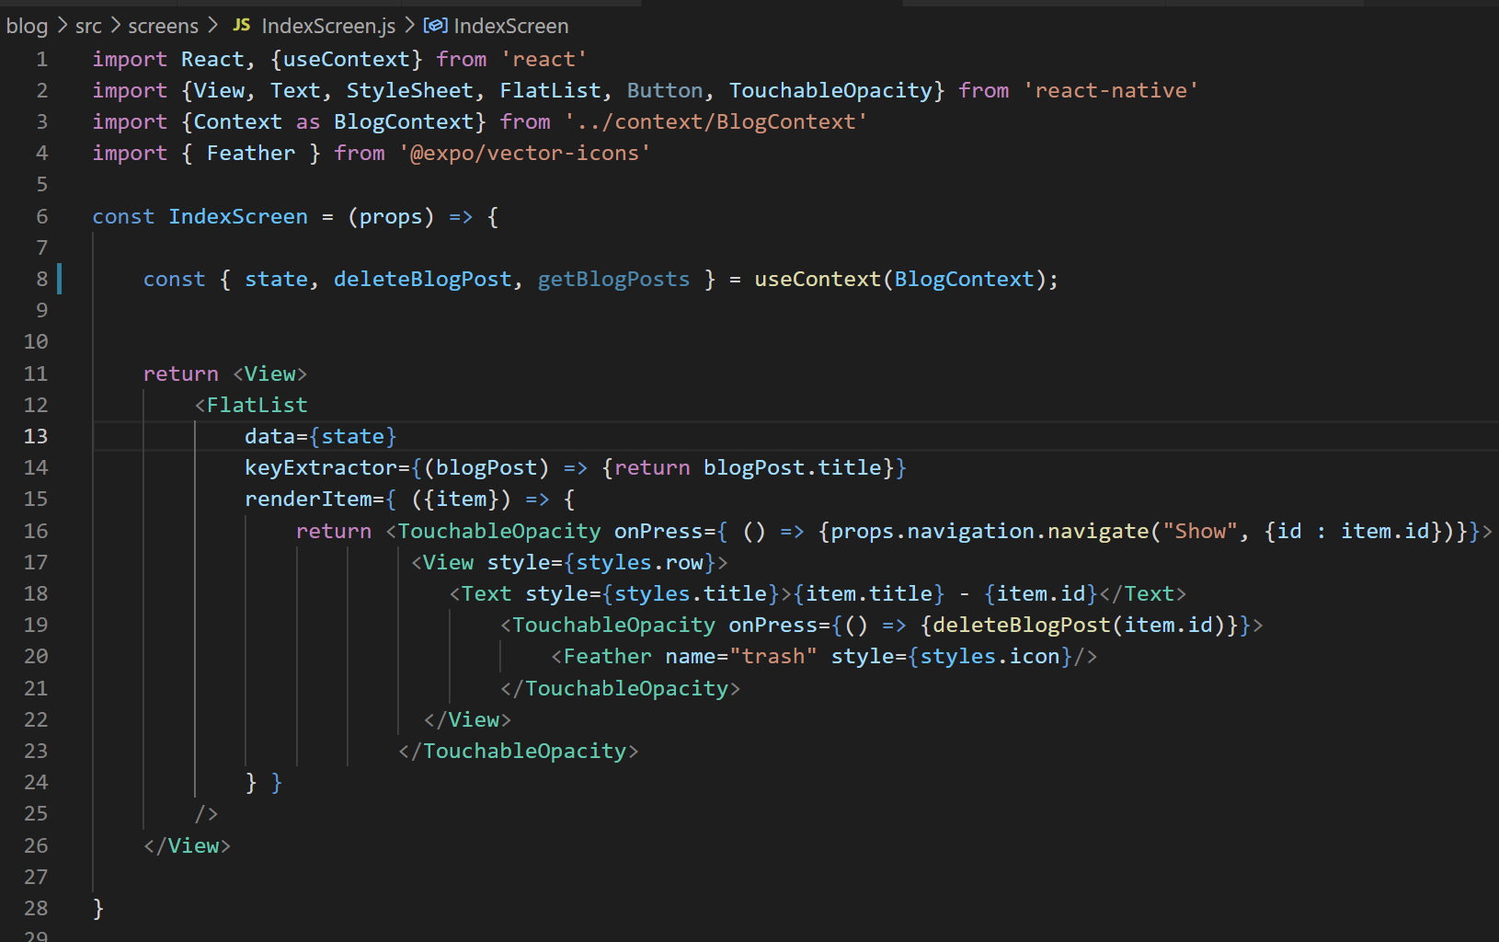

Server Requests
So if we open up IndexScreen…
We can see I’ve already taken the liberty of destructuring it along with our other functions.

Slide 99
Server Requests
So here’s the question.
Now that we have it, where in this file do we call it?
OR alternatively, where would it be very bad to call it?

Slide 100

Server Requests
If we just called it here, we’d get caught in that infinite loop, right?
getBlogPosts makes a network request.
When the request ends, it updates the reducer.
That causes our app to rerender…
Which would call getBlogPosts() to call again…
making a new network request, running the reducer again, etc. etc.
How did we avoid that in the past?

Slide 101
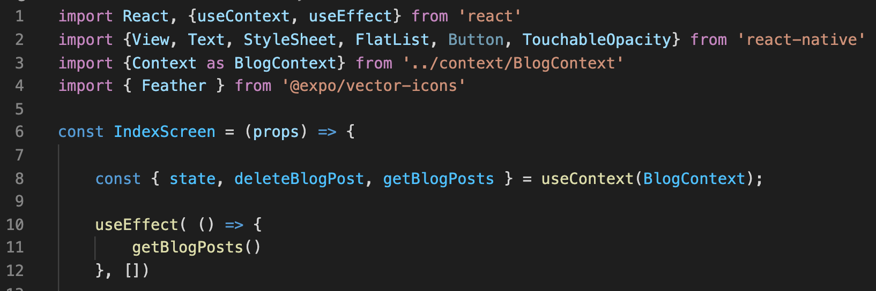

Server Requests
By leveraging the useEffect hook!
That makes code only run *one* time!
Like so!

Slide 102
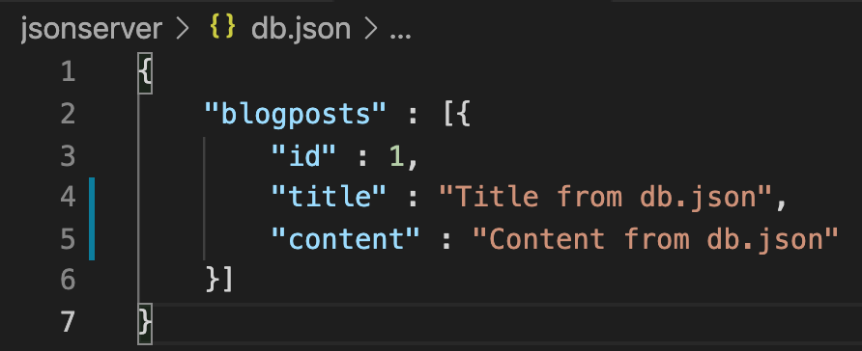
Server Requests
One other quick thing:
Just to test that it is working, let’s add a blog post inside of db.json.
This is pre-populating our ‘database’ with a single object.

Slide 103
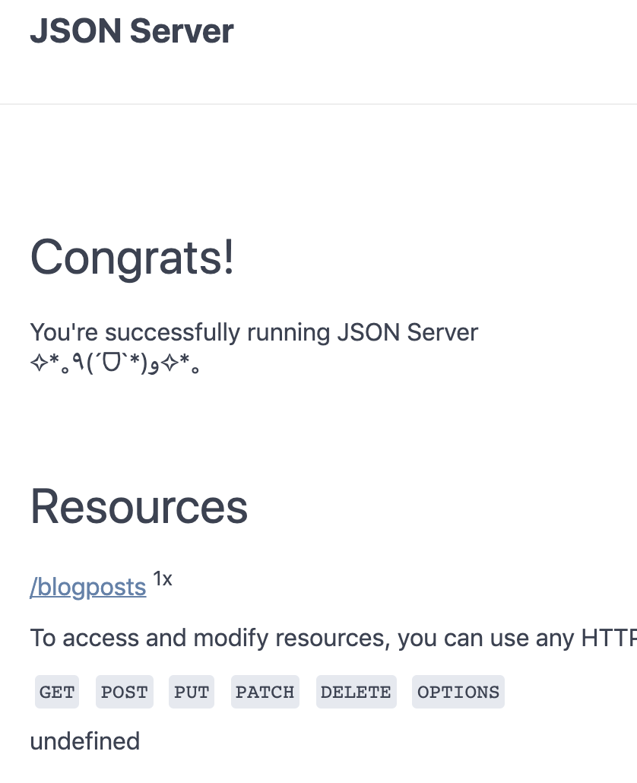
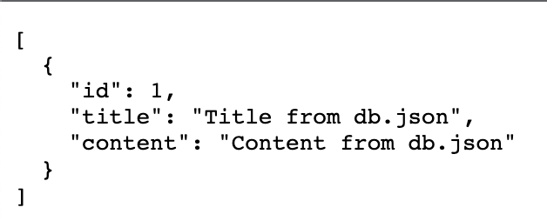


Server Requests
If we go to our server…
And click on the blogposts resource…
We should now see that data!

Slide 104
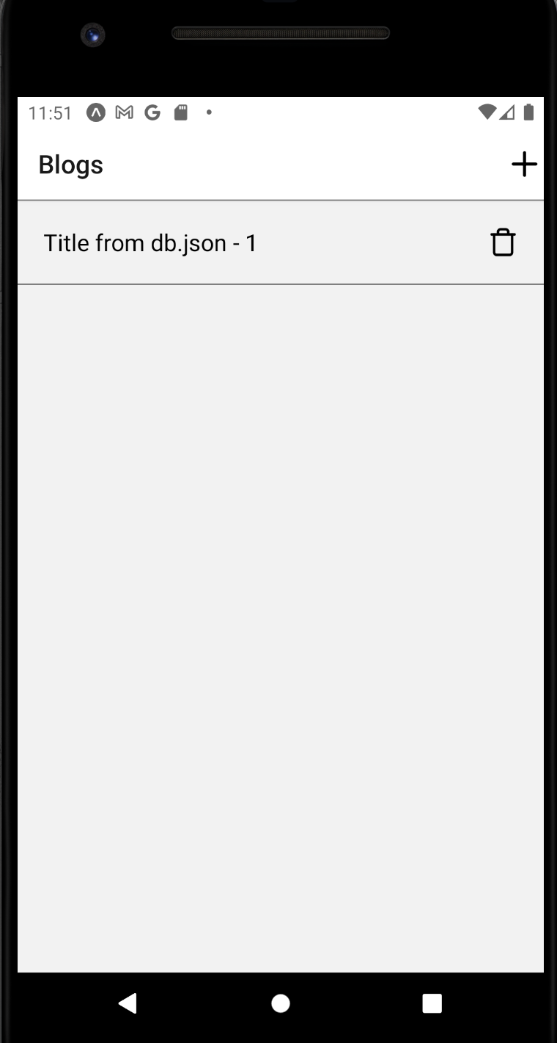
Server Requests
And you should now see it on your phone as well!
Emphasis on *should*
I kept on getting warnings about potential unfulfilled promises.
I kid you not – it took me ~4ish hours to get to a point where it was working consistently.

Slide 105
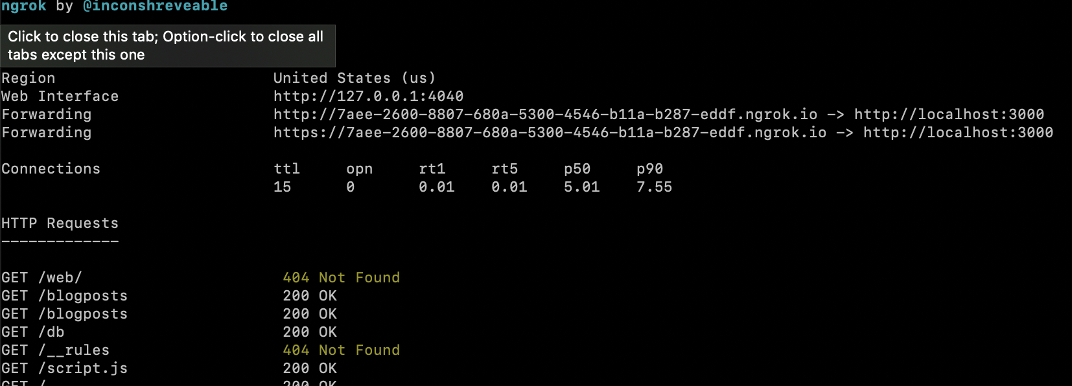
Server Requests
Here are things to double check:
If you’ve switched wifi networks, re run npm run tunnel
Use the first line, the http line, instead of the second line.
Make sure that the address didn’t expire.

Slide 106
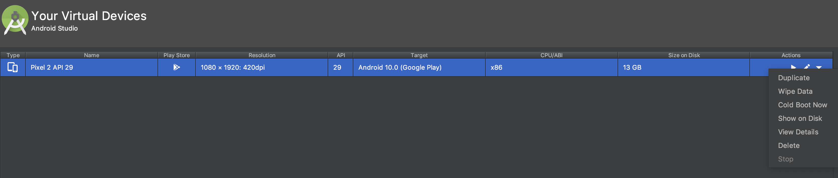

Server Requests
Here are things to double check:
If you are using an emulator, make sure the emulator is connected to wifi (and not just 4g or whatever).
Mine, somehow, WASN’T.
I got it to reconnect by going to the AVD manager in Android Studio, clicking on the dropdown arrow on the far right, and selecting “Cold Boot Now”

Slide 107
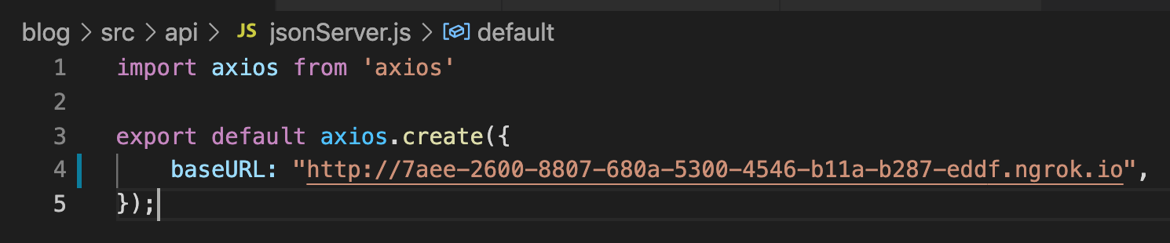
Server Requests
Here are things to double check:
Make sure your axios instance is using your latest and greatest URL.
Make sure that baseURL is spelled just like that, with lowercase ”base” and uppercase “URL”

Slide 108
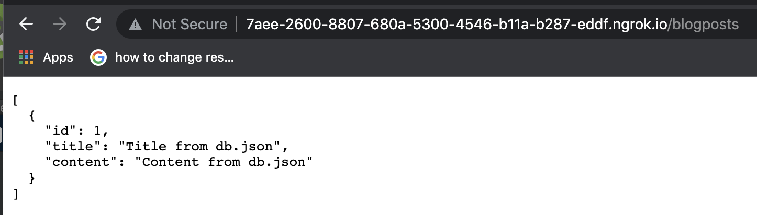
Server Requests
Here are things to double check:
Verify that when you go to the URL that ngrok gives you (not just the JSON server localhost) that the data FROM the JSON server is showing up, like above.

Slide 109
Server Requests
I hope that list of things to verify saves some of you some time.
It will make the time that I forever lost feel more worth it.

Slide 110
Today’s Agenda
Today’s Plan
Setting up json-server
Making Server Requests and Fetching Posts
Creating Posts with Post Requests
Editing, Deleting, and Wrapping Up

Slide 111
Creating Posts
Thankfully, at this point, if you have the network stuff all set up nicely, the rest of this is pretty smooth sailing!
Let’s get it so that we have the capacity to add a blog post!

Slide 112


Creating Posts
It thankfully will end up looking pretty similar to what we just did!
It’s just now we want “addBlogPost()” to make a network request.

Slide 113

Creating Posts
Just to give yourself the gift of focusing on one thing at a time…
We’ll comment out the dispatch and callback function. We’ll only worry about actually adding a new blog post for now.
Also, note that I marked the inner function as async.

Slide 114

Creating Posts
And then we can make our network request using our axios instance!
Note we are using ‘post’ this time instead of get.
In very simple terms: Get is good for reading information without changing it.
Post is good for changing something.
We are going to be adding a new object to our server file, so post makes sense!

Slide 115

Creating Posts
Finally, make sure you also include the object of the new blog post you want to add!
This can be done using the data that this function is already receiving from our previous work.

Slide 116

Creating Posts
And that’s all you need!
Now, if we go to our app and create a new blog post…
Pushing the save button will no longer make us navigate, because we commented it out…
BUT… after pushing it….

Slide 117

Creating Posts
If we navigate back to our db.json file…
You’ll see that we did, in fact, add a new blog post to our array of blog posts.
Also note that, as promised, we didn’t need to specify the id! It was smart enough to do that on its own!

Slide 118

Creating Posts
And if you then refresh your screen…
You’ll see that this new blog post is included as something that gets fetched!
Neato!

Slide 119


Creating Posts
Now, if we go back and uncomment the callback…
Remember, the callback in this action function navigates us back to the index list…

Slide 120




Creating Posts
Then when we make a new blog post and push ‘save’, we DO indeed navigate…
But the third blog post doesn’t show up in our list!

Slide 121


Creating Posts
Though it *did* get created, as we can see in db.json!
So what gives?
Any thoughts?

Slide 122
Creating Posts
Basically, it boils down to useEffect().
Even when we navigate away from IndexScreen…
It’s still “there”, right?
Imagine the stack navigator. If we pop enough, we’ll get back there.
But this useEffect hook will only happen ONE time.

Slide 123

Creating Posts
We can address it by adding an event listener, via the navigation object.
“didFocus” is basically the event of this screen “having focus” again, that is, did we come back to it.
Here, we are saying that when we do come back to it, invoke getBlogPosts() again.

Slide 124


Creating Posts
And now if we make another post and hit save…
It immediately takes us to the index list…
And in like, half a second later, it adds the new post to the list.

Slide 125
Creating Posts
There’s a little something that would be good to add to this though.
Creating a Listener takes up some memory…
And right now, if IndexList were to ever be completely removed (not just navigated away from), we’d have a dangling listener.

Slide 126

Creating Posts
So let’s clean up after ourselves.
When we create the listener, we can get a reference to it.
And here’s a new thing in useEffect…
You can return a function that gets called if/when this component is ever removed.
So, we’ll just say that if IndexScreen is ever gone, we’ll get rid of this listener.
Using listener.remove();

Slide 127
Creating Posts
Technically don’t *have* to do this, but again, it is a nice way to avoid memory leaks.
Not bad!
Great! We can now add new blog posts!

Slide 128
Today’s Agenda
Today’s Plan
Setting up json-server
Making Server Requests and Fetching Posts
Creating Posts with Post Requests
Editing, Deleting, and Wrapping Up

Slide 129

Editing, Deleting, and Wrapping Up
And now, at this point, everything else can basically just fall into place!
How might we update the deleteBlogPost action?

Slide 130

Editing, Deleting, and Wrapping Up
Method
We needed to use the delete request.
Result
GET
http://3d0d-2607-fb90-25d0-ffd9-c96d-7aaf-c6fe-370d.ngrok.io/blogposts
Retrieve all stored blog posts
GET
/blogposts/{id}
Get blog post with particular ID
POST
/blogposts
Create a new blog post.
PUT
/blogposts/{id}
Update blog post with given ID
DELETE
/blogposts/{id}
Delete blog post with given ID

Slide 131

Editing, Deleting, and Wrapping Up
So it might end up looking like this!
Note we are also giving it the id of the blog post we are deleting.
And we can just call dispatch here to update our local copy of the state.
With this in tow, we can once again delete blog posts, AND they disappear from the db.json file as well.

Slide 132

Editing, Deleting, and Wrapping Up
And editing is just as simple!
It uses a put request type.
You need to give it the id of the blog post you are updating, and an object that dictates what its new content should be.
Something like this:

Slide 133

Editing, Deleting, and Wrapping Up
And just like that, we can edit the posts!
Wowzers!

Slide 134
Editing, Deleting, and Wrapping Up
And that’s a wrap on our blog app!
Index
Show
Create
Edit
Blog List
+
Blog List
Blog List
Blog List
Blog Title
Blog Title
My blog post today is going to be about my favorite things. Rain drops on roses and whiskers on Kittens!
Enter Title:
Enter New Title:
Blog Title
Blog Title
Enter Content:
Enter New Content:
Blog Title
Save
Save

Slide 135
Editing, Deleting, and Wrapping Up
Blog Post Provider
blogPost: []
It helped us learn a lot!
Like about keeping all of our data in a Provider
React Navigation Stack Navigator
IndexScreen
ShowScreen
CreateScreen
EditScreen
BlogList

Slide 136
Editing, Deleting, and Wrapping Up
Blog Post Provider
blogPost: []
And making that provider available all over our app using a Context object.
React Navigation Stack Navigator
IndexScreen
ShowScreen
CreateScreen
EditScreen
BlogList

Slide 137

Editing, Deleting, and Wrapping Up
And about CRUD in general!
That’s CREATE, READ, UPDATE, DELETE. The major operations!
Method
Route
Result
GET
/blogposts
Retrieve all stored blog posts
GET
/blogposts/{id}
Get blog post with particular ID
POST
/blogposts
Create a new blog post.
PUT
/blogposts/{id}
Update blog post with given ID
DELETE
/blogposts/{id}
Delete blog post with given ID

Slide 138
Editing, Deleting, and Wrapping Up
We also just learned more about, and saw more examples, and were introduced to…
The vector icon library!
Having icons and buttons in the headers of our screens!
Reducers and state!
Stack navigation, and popping things off the stack!
Setting up (and cleaning up!) event listeners!
Reducing code repetition through clever functions!
The useEffect hook!
And plenty more!

